Slide 1
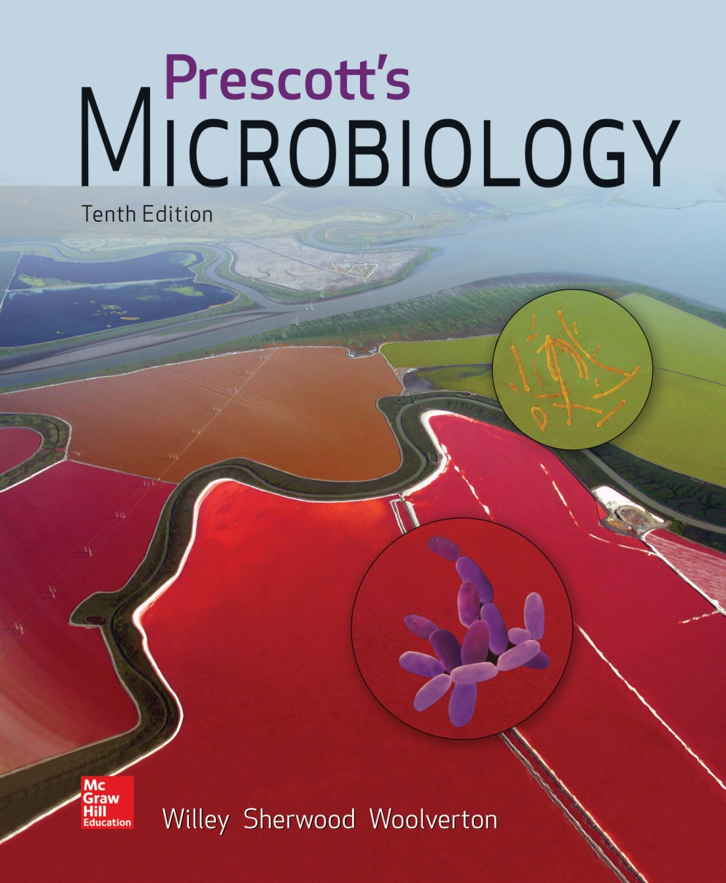
Chapter 24 – Actinobacteria: The High G+C Gram-Positive Bacteria

Slide 2
24.1 Class Actinobacteria
Draw the life cycle of at least two different actinobacteria
Distinguish an exospore from an endospore
Discuss the taxonomic importance of cell wall structure
List common environments in which these microbes can be found

Slide 3
24.1 Class Actinobacteria - 2
List one veterinary and two human diseases caused by actinobacteria
Explain snapping division and how this results in the palisade arrangement of cells
Relate the structure of mycolic acids to the properties of mycobacterial cell walls
Relate the unusual carbon and energy substrates used by bacteria in the family Nocardiaceae and to their importance in bioremediation

Slide 4
24.1 Class Actinobacteria - 3
Describe the unusual morphology of actinoplanete spores
Name two reasons proprionibacteria are important to humans
Explain how streptomycete morphology helps this group thrive in soils
Discuss the origin of the antibiotic streptomycin and list five other medicinal agents made by the streptomycetes

Slide 5
24.1 Class Actinobacteria - 4
Describe the morphology of Frankia spp., relate this to their colonization of plants, and explain the advantage these bacterial symbionts confer to plants such as alder trees
Describe the morphology of members of Bifidobacteriaceae
Differentiate between the human pathogenic and nonpathogenic members of class Actinobacteria

Slide 6
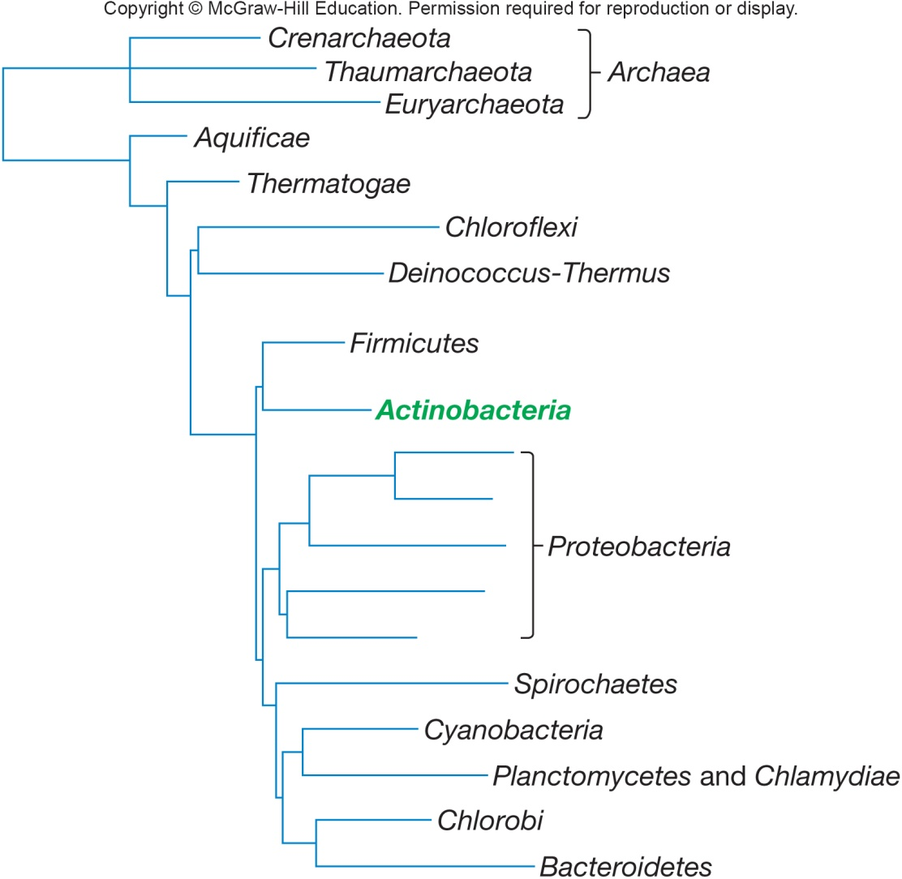
High G + C Bacteria
Volume 4 of Bergey’s Manual of Systematic Bacteriology, 2nd Edition
Actinomycetes
Gram-positive, aerobic bacteria that produce filamentous cells called hyphae and differentiate into asexual spores
adapt to climates similar to fungi

Slide 7
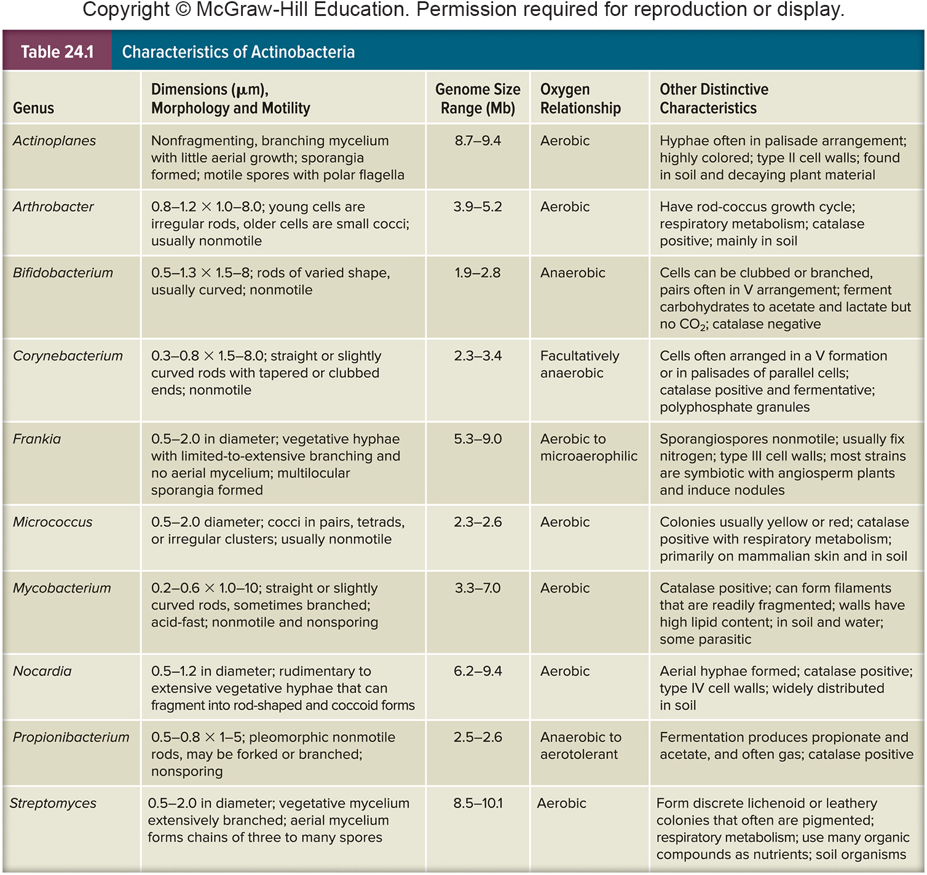
Characteristics of Actinobacteria

Slide 8
General Properties of the Actinomycetes
Source of most currently used antibiotics
Also produce metabolites that are anticancer, antihelminthic, and immunosuppressive
Complex life cycle
Most are not motile
motility is restricted to flagellated spores

Slide 9
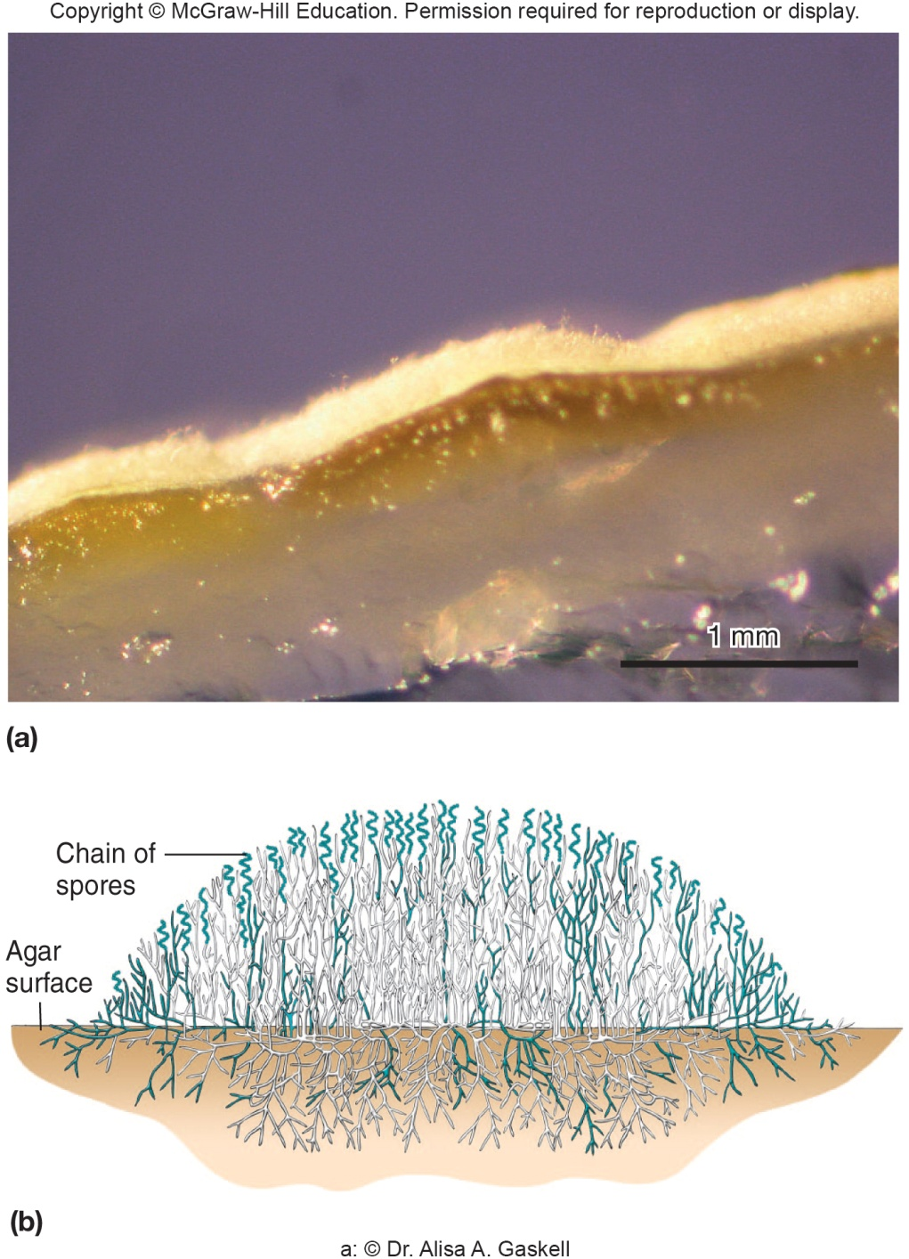
Life Cycle of Actinomycetes
Involves development of filamentous cells (hyphae) and spores
Hyphae can form branching network
grow on surface of substrate/into it to produce a substrate mycelium
some hyphae differentiate to form an aerial mycelium which extends above substratum
at this stage secondary metabolites form, some of which are medically useful

Slide 10
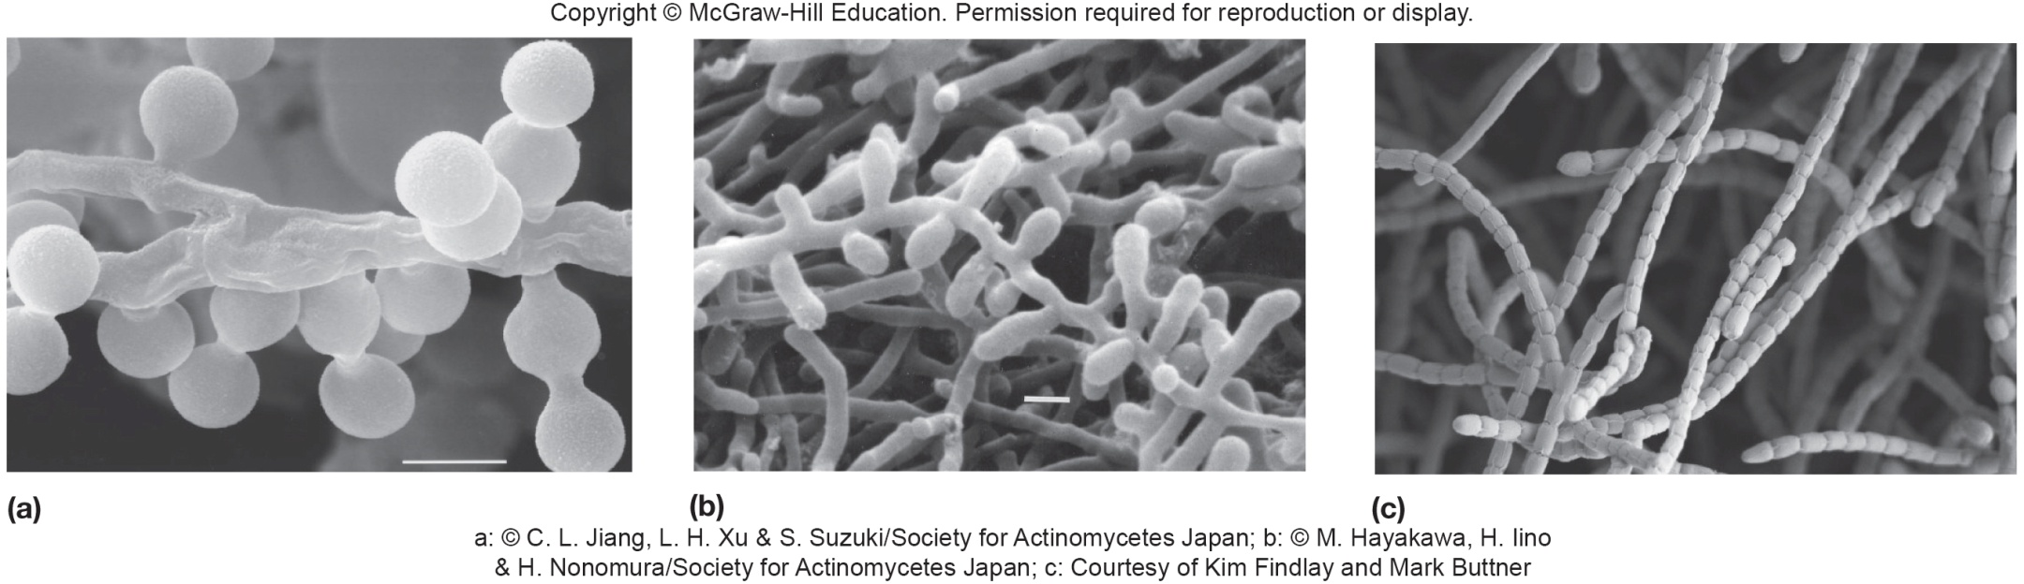
Life Cycle of Actinomycetes – Aerial Mycelia
Aerial mycelium
form exospores which are called sporangiospores if they are located in a sporangium
produced in response to nutrient deprivation
withstand desiccation but not heat resistant
spores dispersed by wind for new bacteria

Slide 11
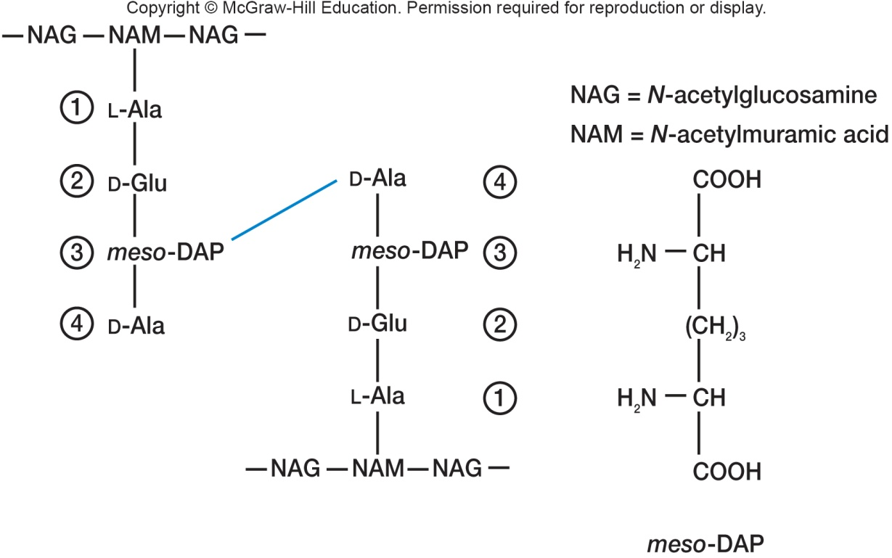
Ecological Significance of Actinomycetes
Widely distributed in soil
Play important role in mineralization of organic matter
Most are free living, but a few are pathogens
Characteristics used in Actinomycete taxonomy
four major cell wall types based on peptidoglycan structure and sugar content other than N-acetylglucosamine and N-acetylmuramic acid

Slide 12
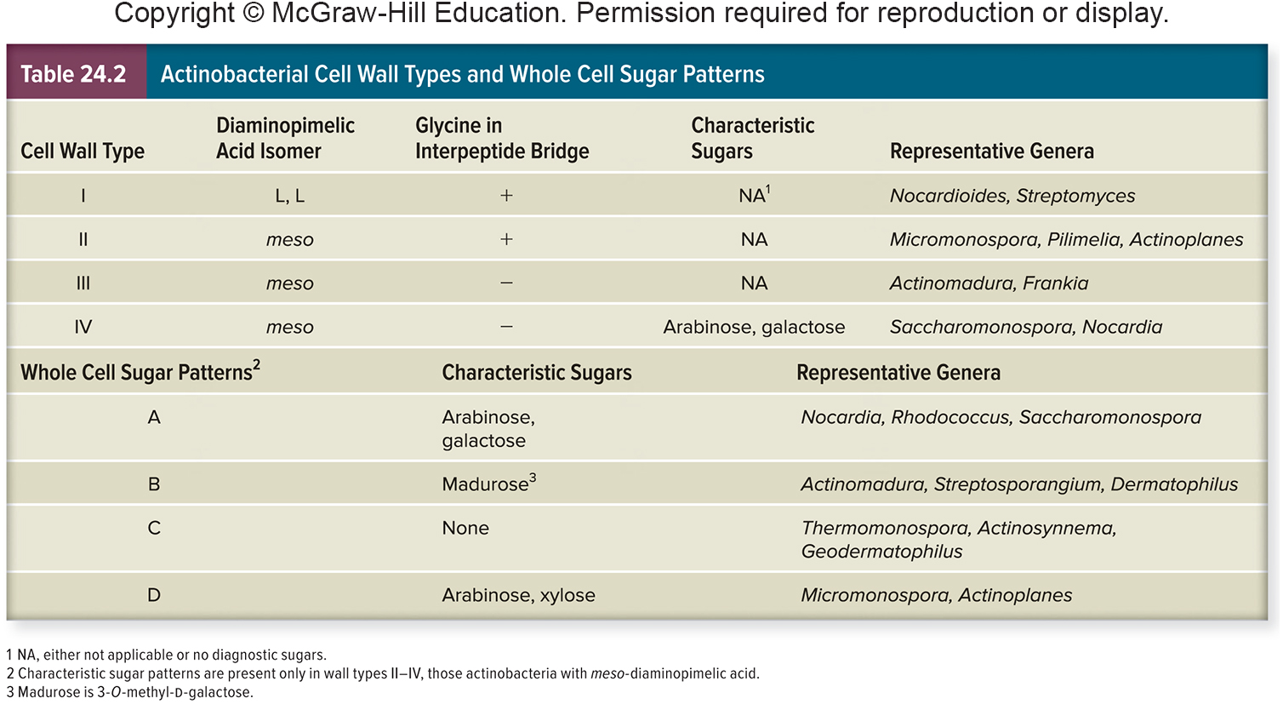
Actinobacterial Cell Wall Types

Slide 13
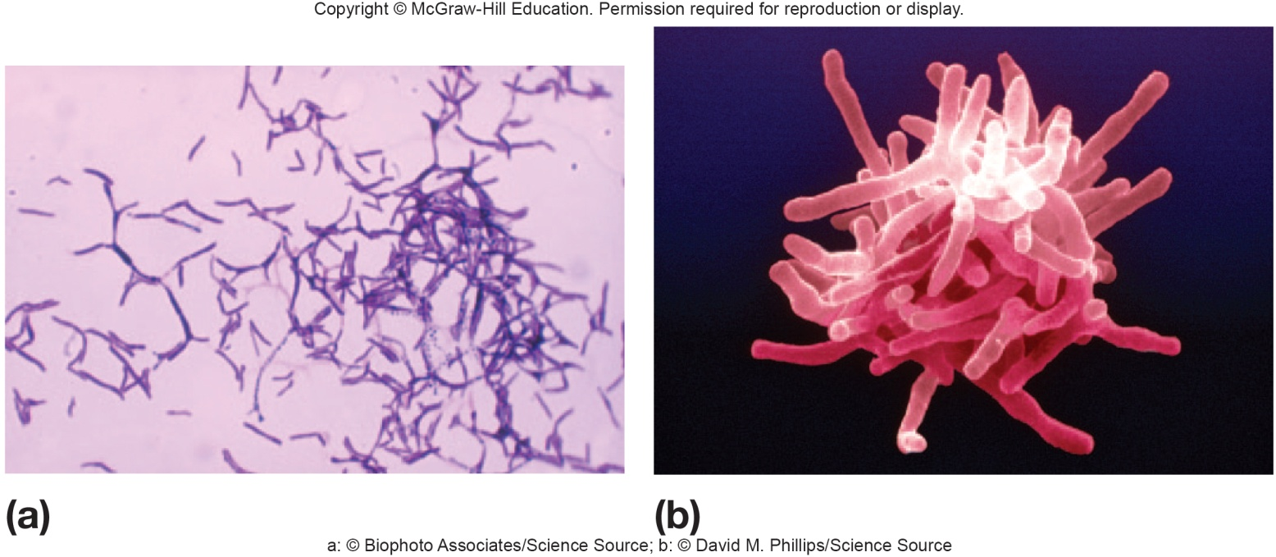
Order Actinomycetales
Includes genera Actinomyces, Actinobaculum, Arcanobacterium, and Mobiluncus
Irregularly shaped, non-sporing, Gram-positive rods
swelling, club shapes, or other deviations from normal rod morphology
Aerobic, facultative, or microaerophilic metabolism

Slide 14
Genus Actinomyces
Straight or slightly curved rods and slender filaments with true branching
may have swollen, clubbed, or clavate ends
Facultative or obligate aNAerobes (require CO₂)
Peptidoglycan contains lysine and not diaminopimelic acid or glycine
Normal inhabits of oral mucosa
cause of lumpy jaw in cattle
ocular infection, actinomycoses, and peridontal disease in humans

Slide 15
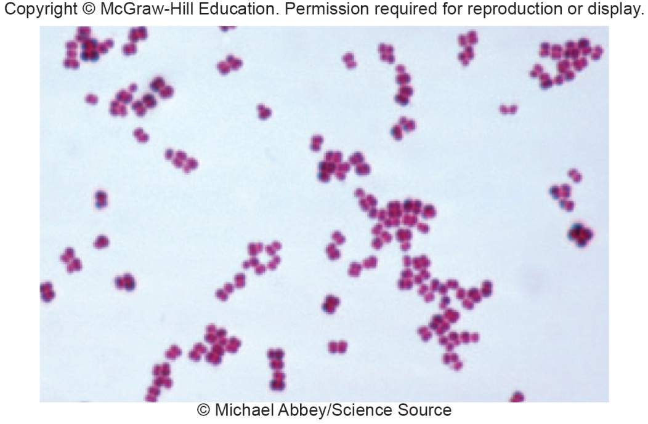
Order Micrococcales, Genus Micrococcus
Aerobic, catalase-positive rods cocci that occur in pairs, tetrads, or irregular clusters
Usually nonmotile
Often pigmented yellow, orange, or red
Widespread in soil, water, and on human skin
Does not undergo morphological differentiation

Slide 16
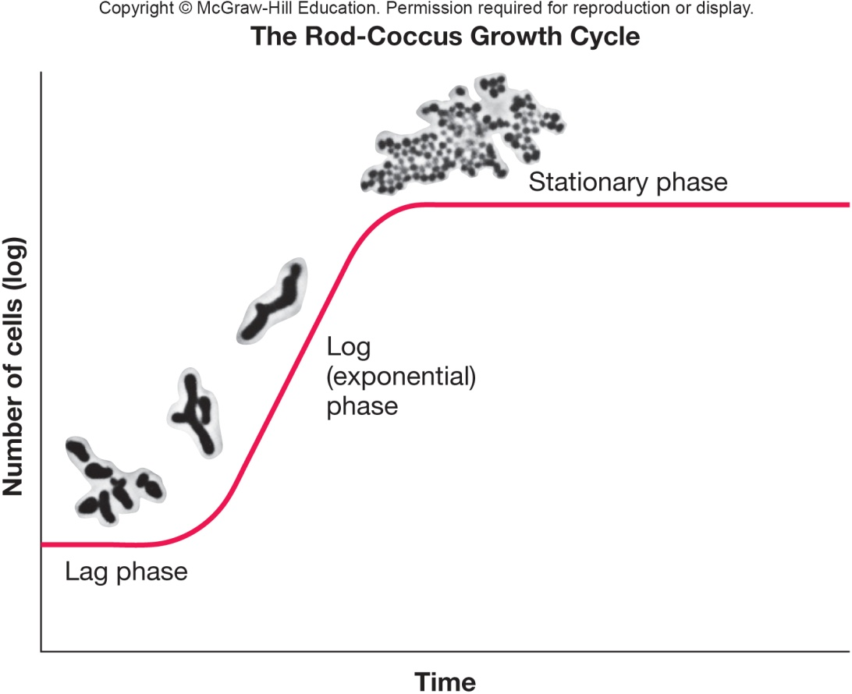
Order Micrococcales, Genus Arthrobacter
Aerobic, catalase-positive rods, respiratory
Lysine in peptidoglycan
Rod-coccus growth cycle
exponential phase
irregular, branched rods
reproduce by snapping division
early stationary phase
begin to change to coccoid form
when transferred to fresh medium, coccoid cells produce outgrowths of actively growing rods

Slide 17
Order Corynebacteriales Includes Important Human Pathogens
Has seven families with many known genera such as:
Corynebacterium
Mycobacterium
Nocardia

Slide 18
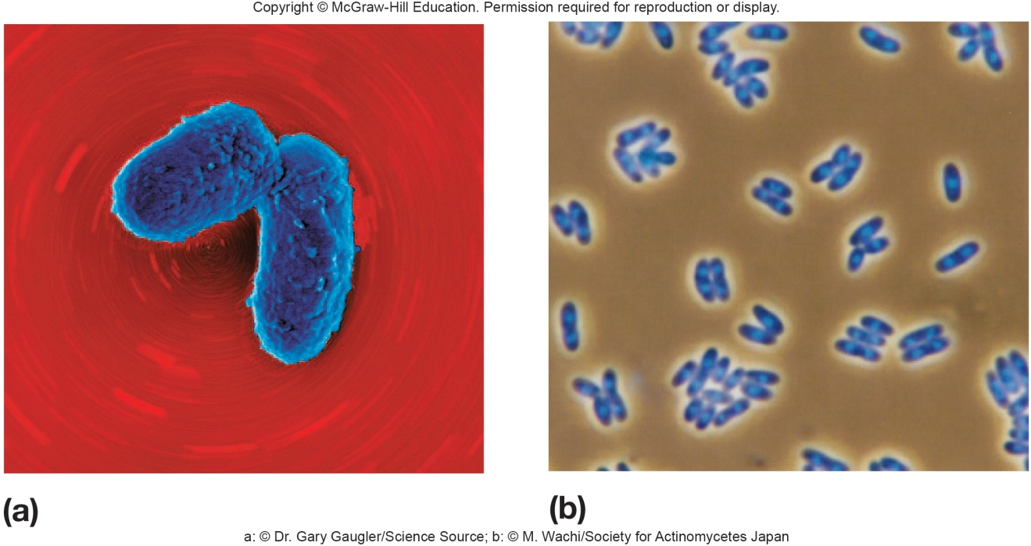
Genus Corynebacterium
Aerobic and facultative, catalase positive
Straight to curved rods with tapered ends and club shaped
After snapping division bacteria often remain partially attached resulting in palisade arrangements of cells
Some are harmless soil and water saprophytes
Many are animal and human pathogens
e.g. C. diphtheriae - diphtheria

Slide 19
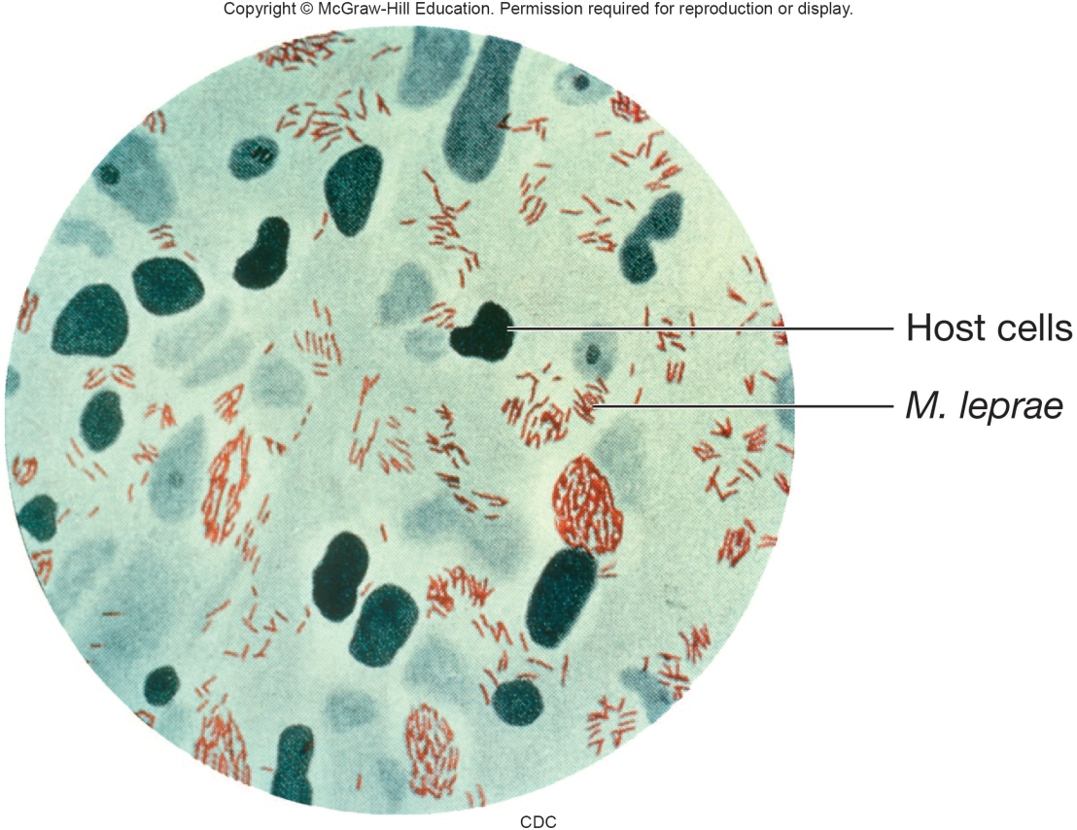
Genus Mycobacterium
In family Mycobacteriaceae
straight or slightly curved rods that sometimes branch or form filaments
Aerobic and catalase positive
Filaments readily fragment into rods and coccoid bodies
Very slow growing on culture media

Slide 20
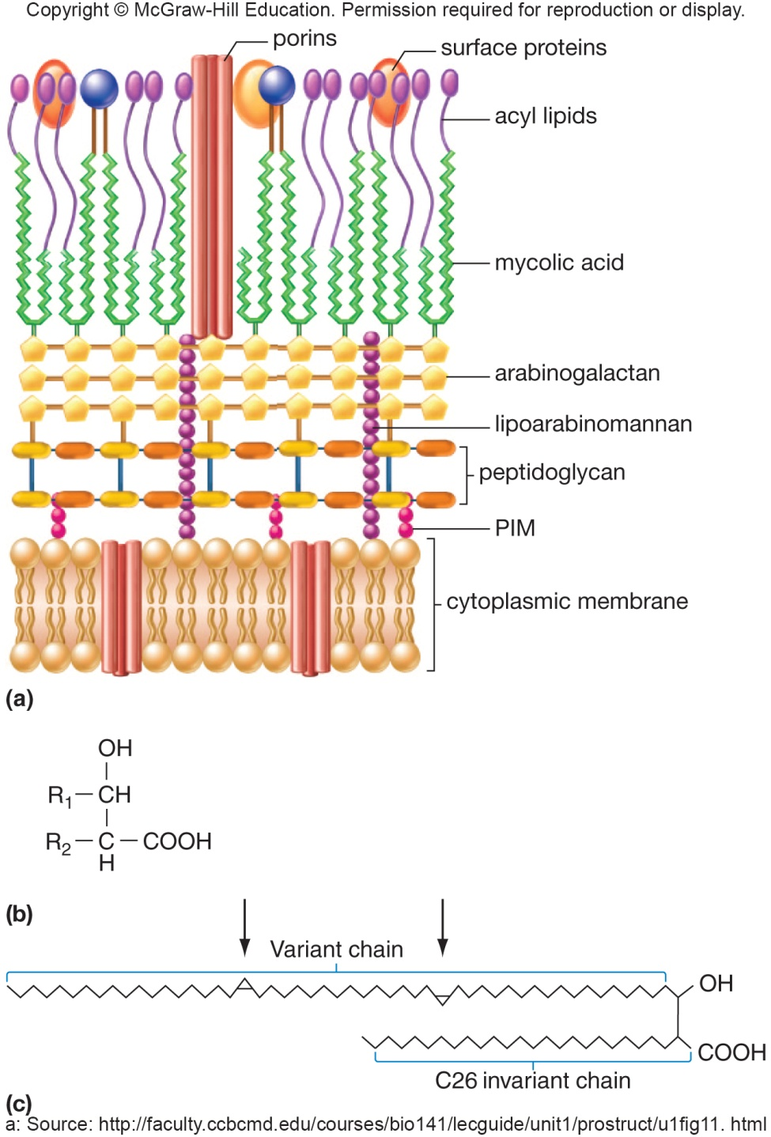
Mycobacterial Cell Walls
Contain waxes with 60 to 90 carbon mycolic acids
Mycolic acids linked to peptidoglycan by arabinogalactan, a polysaccharide
cell walls very hydrophobic
impenetrable by antibiotics
acid-fast
basic fuchsin dye not removed by acid alcohol treatment

Slide 21
Important Species of Mycobacterium
M. bovis
tuberculosis in cattle, humans
M. tuberculosis
tuberculosis in humans
M. avium complex (MAC)
various diseases
M. leprae
leprosy

Slide 22
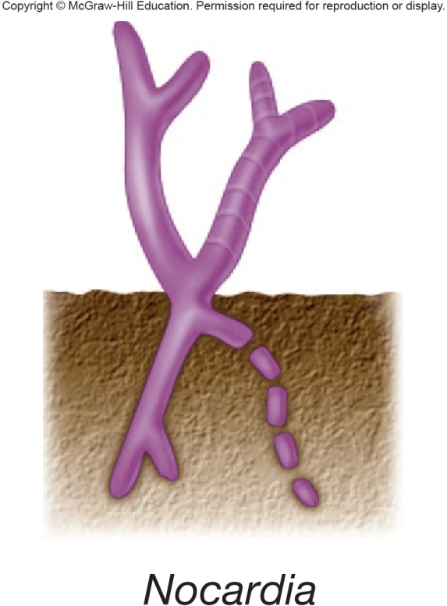
Genus Nocardia
Along with genus Rhodococcus make up the family Nocardiaceae
Develop a substrate mycelium that readily breaks into rods and coccoid elements
Some also form an aerial mycelium and conidia

Slide 23
Impact of Nocardia
Most are free-living saprophytes
can degrade many molecules
e.g. petroleum hydrocarbons, detergents, benzene
involved in biodegradation of rubber joints in water and sewage pipes
Some are opportunistic pathogens causing nocardiosis
usually infect lungs; can infect central nervous system

Slide 24
Genus Rhodococcus
Widely distributed in soils and aquatic habitats
Degrade an enormous variety of molecules such as
petroleum hydrocarbons, detergents, benzene, polychlorinated biphenyls (PCBs), various pesticides
may reduce sulfur from fuels and reduce air pollution from sulfur oxide emissions

Slide 25
Order Micromonosporales Includes Bacteria That Produce Morphologically Diverse Spores
Contains genera Micromonospora, Dactylosporangium, Pilimelia, and Actinoplanes
Often generally called actinoplanetes
extensive substrate mycelia
lack or have rudimentary aerial mycelia
sporangiospores motile or nonmotile
found in soil and aquatic habitats (especially freshwater)
soil dwellers play important roles in plant and animal decomposition
some produce antibiotics

Slide 26
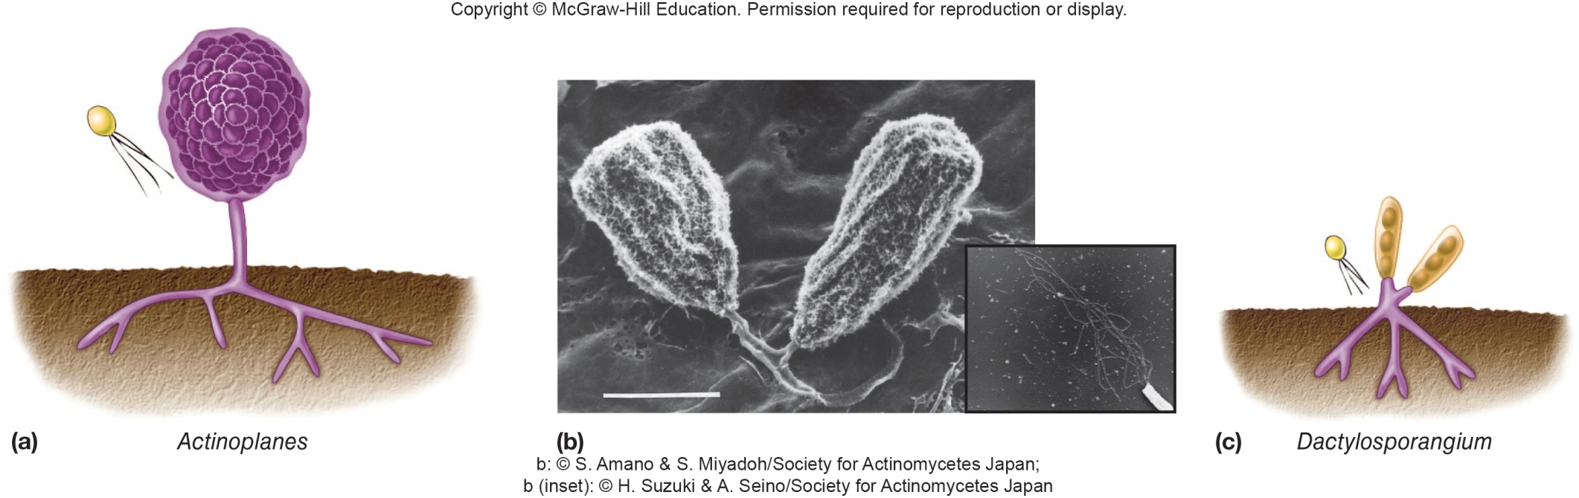
Micromonosporaceae

Slide 27
Order Propionibacteriales, Genus Propionibacterium
Found on skin and in digestive tract of animals
also in dairy products such as cheese
used in production of Swiss cheese
e.g. P. acnes – involved in development of body odor and acne vulgaris

Slide 28
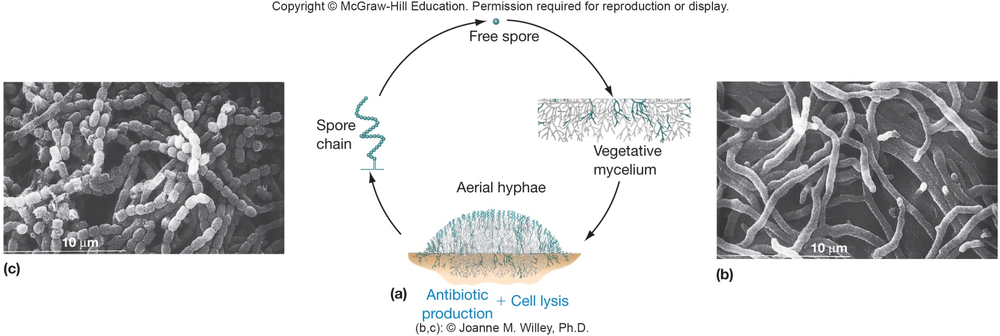
Order Streptomycetales: An Important Source of Antibiotics
One family, three genera (most important is Streptomyces)
Streptomyces is a large genus – about 150 species, all strict aerobes
Microbes in this family are generally known as streptomycetes
Aerial hyphae that divide in single plane to form chains of spores
Filaments grow by tip extension

Slide 29
Genus Streptomyces
Are 1 to 20% of culturable soil microbiota
produce geosmin
volatile substance that is source of moist earth odor
important in mineralization process
aerobically degrade many resistant substances (e.g., pectin, lignin, and chitin)
Produce vast array of antibiotics, other bioactive compounds, and antibiotic resistance genes
Most are nonpathogenic saprophytes

Slide 30
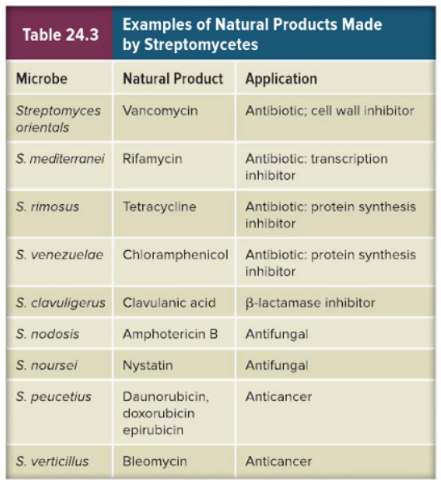
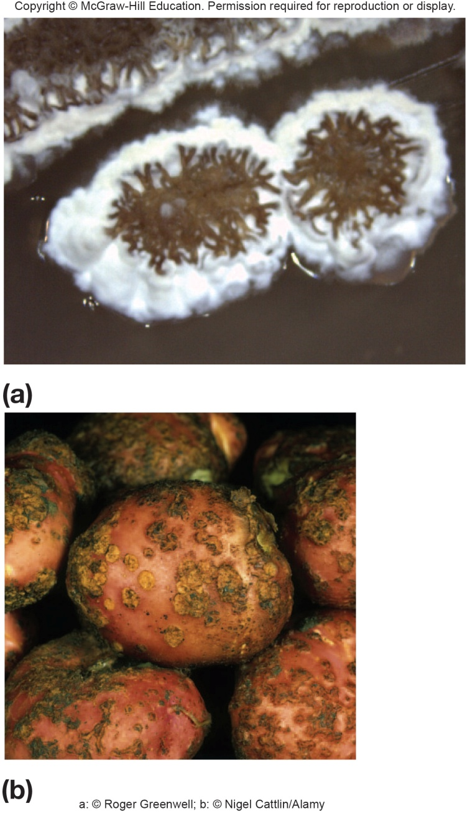
Streptomycetes and Their Products

Slide 31
Streptomyces coelicolor
One of the largest bacterial genomes, 8.67 Mbp
largest number of genes (7,825)
65 RNA polymerase sigma subunits
80 two-component regulatory systems
Over 50 secreted degradative enzymes

Slide 32
Pathogenic Streptomycetes
Streptomyces scabies
scab disease in potatoes and beets
Streptomyces somaliensis
actinomycetoma
infection of subcutaneous tissues in humans
leads to swelling, abscesses, and bone destruction

Slide 33
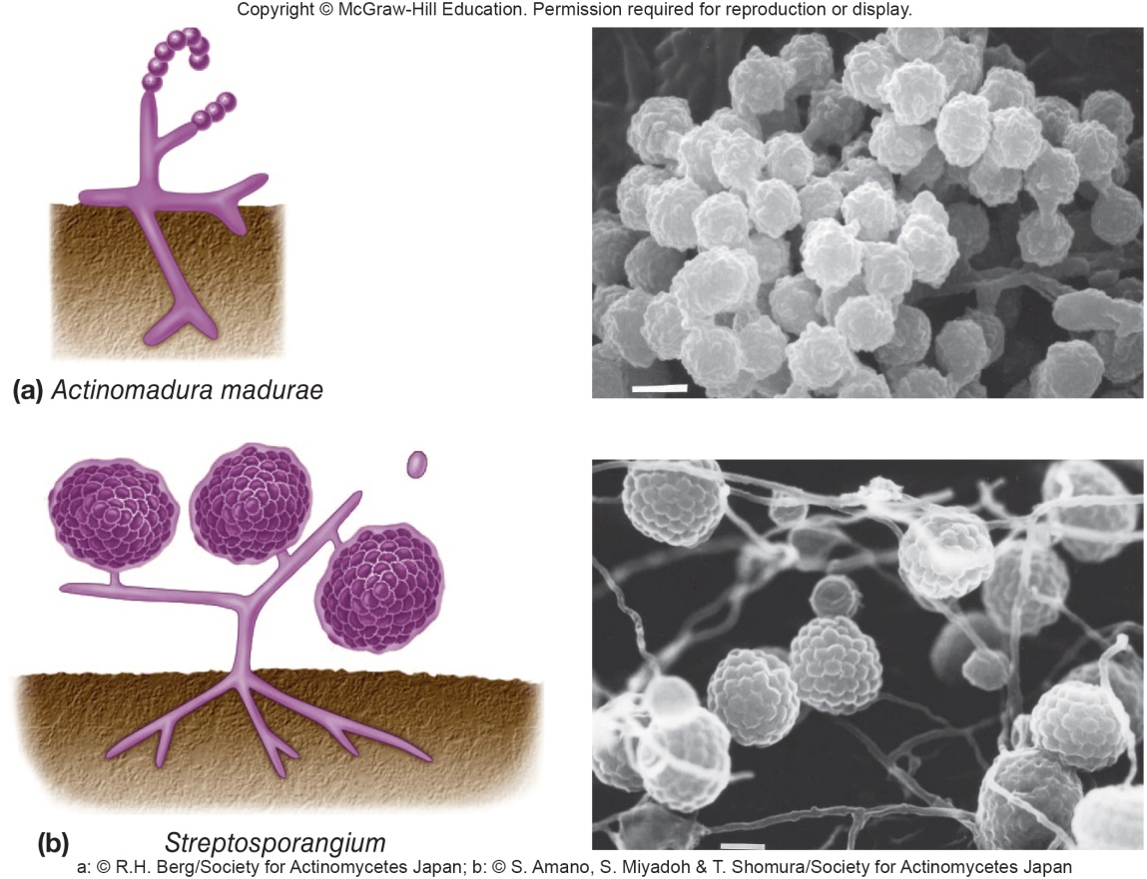
Order Streptosporangiales
Aerial mycelia bear pairs or short chains of spores
whole cell homogenates contain sugar madurose
Members of some genera form sporangia, but their spores are not heat-resistant
Some have been isolated from moderately high-temperature habitats such as compost piles and hay and can grow at 40-48° C

Slide 34
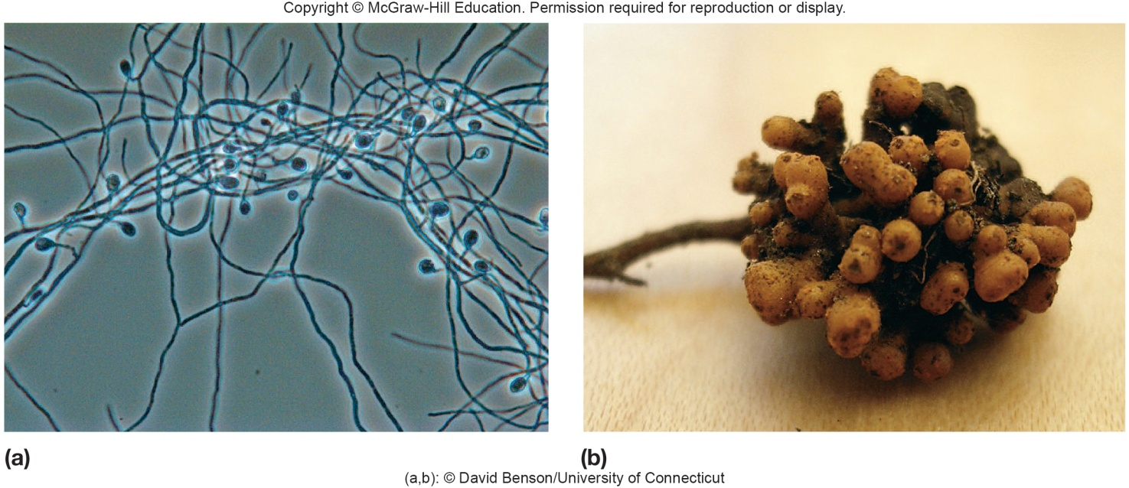
Order Frankiales: Bacteria That Fix N₂ in Trees
Genera Frankia and Geodermatophilus
both form multilocular sporangia characterized by clusters of spores
Geodermatophilus
motile spores, aerobic
Frankia
nonmotile spores, microaerophile, fixes nitrogen, symbiotic with nonleguminous plants

Slide 35
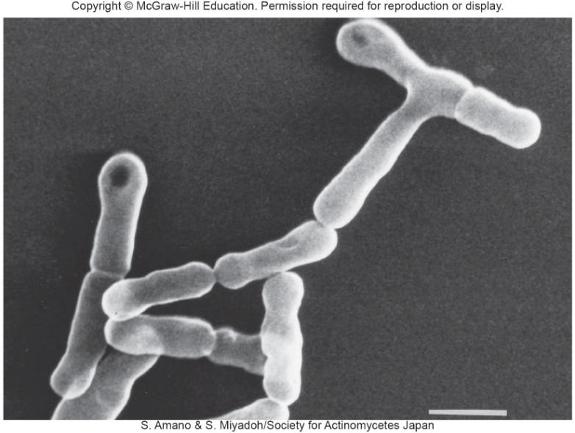
Order Bifidobacteriales: Pathogens and Probiotics
Includes members of genera Falcivibrio and Gardnerella
found in human genitourinary tract
Gardnerella thought to be major cause of vaginitis
e.g. Bifidobacterium
nonsporing, anaerobic, Gram-positive rods, slightly curved or clubbed-shaped
found in mouth and intestinal tract of warm-blooded animals, in sewage, and in insects
May have benefits as commensal microbe in gut of humans and other animals, providing healthy benefits

Slide 36
Take Home Message
This may be one of the shortest chapters in this textbook, but it has information on some of the most important microbes
Some of these microbes are used extensively to produce antibiotics; others can be part of the normal microbiome of human beings, becoming opportunistic pathogens on occasion
Still others in these groups are important members of soil and other microbial habitats on this planet
While they may not seem as important as some of the other microbes in other areas of the text, try to identify what might happen if these groups of microbes suddenly disappeared – it generally wouldn’t be a good outcome in many situations

